Slide 1
Stochastic Modelling For Stock Price Forecasting
Monte Carlo simulations

Slide 2
Problem Statement
Given price of today’s stock, we want to predict what will be its price tomorrow. For this our goal is to develop a Stochastic Modelling Method called “Monte Carlo Method” to stimulate how market will behave for next 100 days for a particular stock. Data we use here is from yahoo finance. We use 3 stock portfolios of Google, Facebook and Apple.

Slide 3
Stochastic Modelling
Stochastic modeling is a form of financial model that is used to help make investment decisions. This type of modeling forecasts the probability of various outcomes under different conditions, using random variables.

Slide 4
Why Stochastic Models?
Deterministic Models produce same outputs for given set of input. Whereas Stochastic Models presents predicts outcomes that account for certain levels of unpredictability or randomness.
Example:-
Let us say the market-price of some portfolio is 10 bucks today. What will it be tomorrow? Theoretically, it can be anything! But we can argue, intuitively, that there is a higher probability that it is either 9 bucks or 11 bucks and a very low probability that it is 100 bucks.

Slide 5
Monte Carlo Simulation
Monte Carlo simulations are used to model the probability of different outcomes in a process that cannot easily be predicted due to the intervention of random variables. It is a technique used to understand the impact of risk and uncertainty in prediction and forecasting models.
A variety of fields utilize Monte Carlo simulations, including finance, engineering, supply chain, and science.
The basis of a Monte Carlo simulation involves assigning multiple values to an uncertain variable to achieve multiple results and then averaging the results to obtain an estimate.

Slide 6
Steps of Monte Carlo Simulation
Obtain Stock data of google, Facebook and apple with help of yFinance module in python.
Compute Logarithmic Daily Returns
Daily returns =ln(Day's Price/Previous Day's Price)
Calculate Drift
Drift = Average daily return - (Variance/2)
Compute Daily Returns
Next day’s Price = Today’s Price*exp(Random value + Drift)
Run the Monte Carlo simulation for a single stock
Run the complete Monte Carlo simulation for as many stocks as needed!

Slide 7
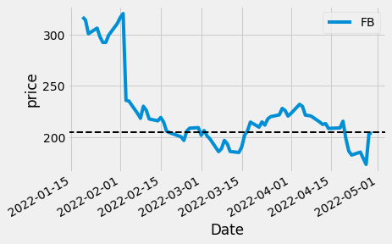
Results:-
For single simulation of Facebook data

Slide 8
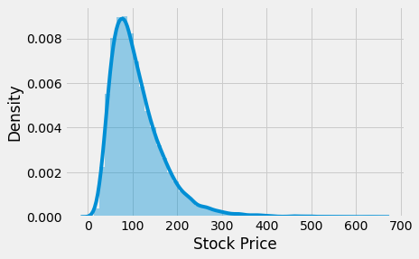
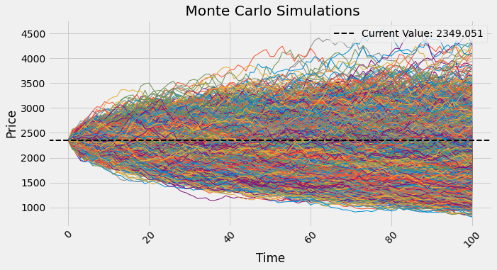
Results:-
For Google data
GOOGLE
Days: 100
Expected Value: $1912.96
Return: -22.8%

Slide 9
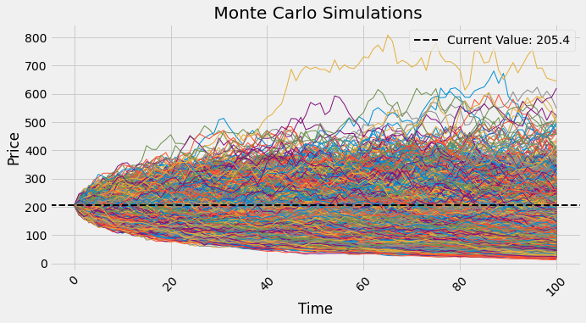
Results:-
2) For Facebook data
Facebook
Days: 100
Expected Value: $110.79
Return: -85.39%

Slide 10
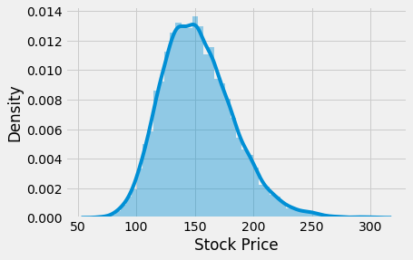
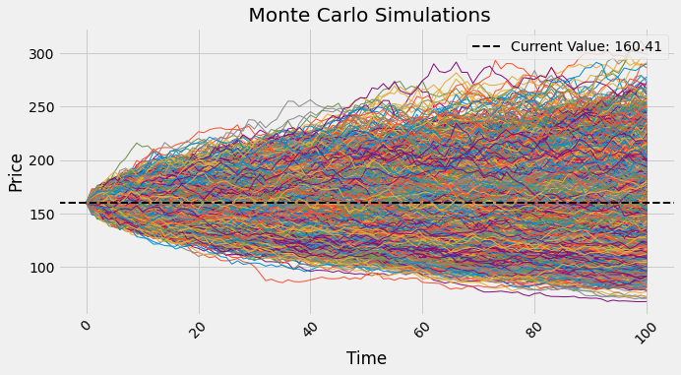
Results:-
3) For Apple data
Apple
Days: 100
Expected Value: $152.62
Return: -5.11%

Slide 11
Conclusion
Monte Carlo simulations help to explain the impact of risk and uncertainty in prediction and forecasting models. Once we run the simulation, we can observe the distribution of values at the end date, which depends on the amount of days forecasted. The metrics for each stock, i the average return and the risk-adjusted return are also calculated.
Disadvantage of this method is that it assumes an efficient market. It cannot account for recession or any other financial crisis due to factors such as change in company leadership or an ongoing pandemic.

Slide 12
References
https://www.investopedia.com/artic
les/investing/112514/monte-carlo-simulation-basics.asp
https://www.investopedia.com/terms/m/montecarlosimulation.asp
https://github.com/Gustrigos/Stochastic-Modeling
Code - https://colab.research.google.com/drive/1cN3Zc08udsTJMKoxfSWIfwhL4EbKm1ZD?usp=sharing

